Slide 1
CouchDB replication and conflict detection
Andrew Browne
@adbrowne

Slide 2
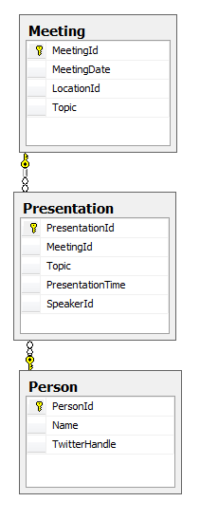
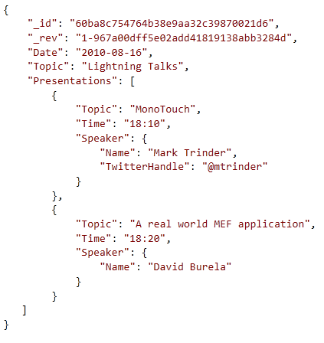
Database Schema?

Slide 3
Want More?
The CouchDB Project http://couchdb.apache.org/
CouchDB wiki: http://wiki.apache.org/couchdb/
CouchDB: The Definitive Guide http://books.couchdb.org/relax/

